Slide 2
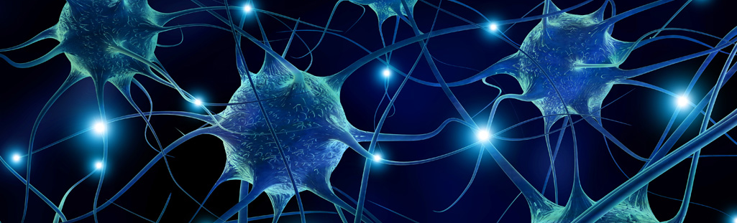
DANDRITE – Danish Research Institute of Translational Neuroscience
XXXX meeting, June YY^{th} 201W
Notes:
This slide is suggested for acknowledgements at the end of the presentation. Please just delete it if you do not find it appropriate.

